Slide 1

Design and Verification of NAND Flash based Memory Controller
ECE 571 Introduction to System Verilog
FINAL PROJECT
Manjush Padmamma Venkatesha
Lakshmi Manoja Kavuri
Sumeeth Budhi Mahaveer
Yash Hiremath

Slide 2
TEAM CONTRIBUTION
Basic environment of design : Manjush
Design in SV : Manjush
Tested Design with Basic testbench : Manjush
Verification Plan : Sumeeth & Manjush
Deterministic approach of Verification : Manjush & Yash
Functional Verification : Sumeeth
Synthesized in DC : Sumeeth
Unit Testing in emulation : Manoja & Yash
Emulating design on velocesolo : Manoja & Yash

Slide 3
Overview
Designed NAND Flash based Memory Controller (buffer and controller).
Unit testing of each module to check its functionality.
Verification approach
Deterministic approach.
Functional Verification.
Emulation in TBX Mode (BFM).

Slide 4
Proposed objectives
Design, Verification & Emulation for NAND FLASH based Memory Controller
Operations to be performed:
Reset
Program Page
Page Read

Slide 5
Additional Improvements
Memory Design for Memory Controller
Additional operations :
Block Erase
DC Synthesis
Realized netlist
Verification :
Implementation of scoreboard

Slide 6
Design Aspects
Design of Memory Controller
Buffer
Controller
Top Design Model
Memory Controller
Memory

Slide 7
Design Aspects
Operations Implemented
Reset Memory Controller
Block Erase
Program Page
Page Read

Slide 8
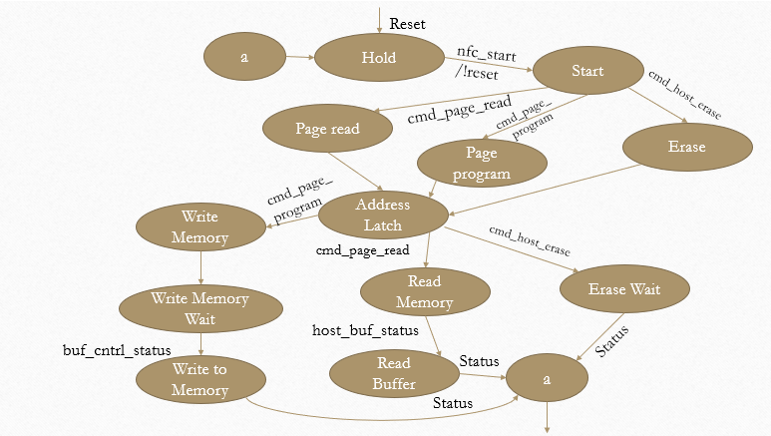
Controller Design

Slide 9

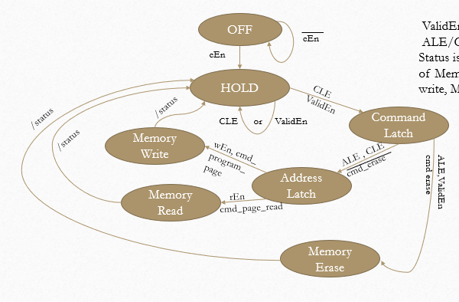
Memory Design
ValidEn & ALE/CLE/rEn/wEn=1
Status is asserted on transition of Memory read, Memory write, Memory erase states

Slide 10
Buffer Design
Buffer Write
Buffer Read
Counter Implementation for Buffer Depth
Designed to handle data coherence
Buffer overwrite
Buffer read termination

Slide 11
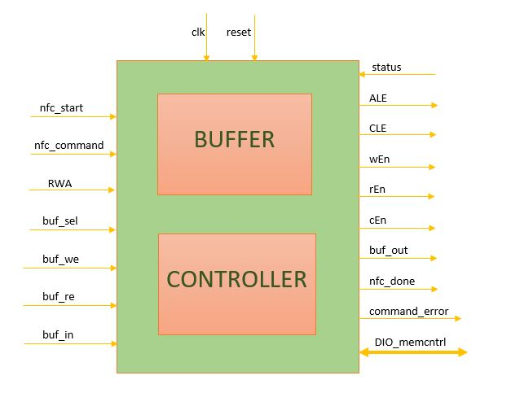
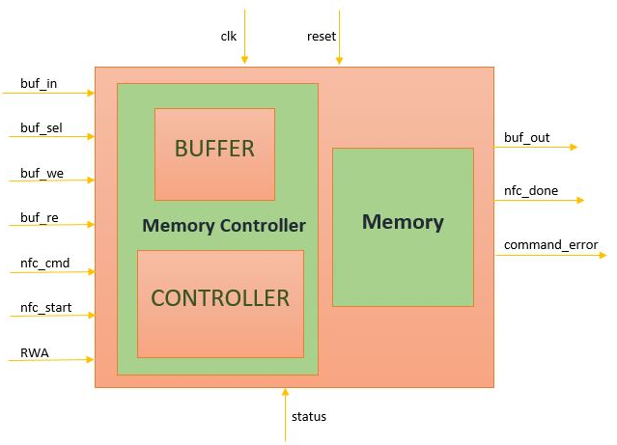
Block Diagram

Slide 12
Verification Types
Deterministic Approach
Functional Verification

Slide 13
Deterministic Approach
Establish test environment
Interface & Top Module Interactions
Forcing input test vectors.
Monitor DUT response on waveforms and transcript

Slide 14
DETERMINISTIC APPROACH ENVIRONMENT
Top Environment
PACKAGE
DUT
I
N
T
E
R
F
A
C
E
Test
Bench

Slide 15
Functional Verification
Create test environment
Interface
Test Environment
Top Environment
Constraint Randomization
Generating packets of test vectors
Driving test vectors
Monitor the response
Assert the response and score it

Slide 16
FUNCTIONAL VERIFICATION ENVIRONMENT
Top Environment
Clk Reset
PACKAGE
Test Environment
Driver
I
N
T
E
R
F
A
C
E
DUT
MAIL BOX
MONITOR
Generator
MAIL BOX
SCORE BOARD
Transaction

Slide 17
Functional Verification
Verification approach using
Constraint randomization
Assertions
Clocking
Properties
Interfaces

Slide 18
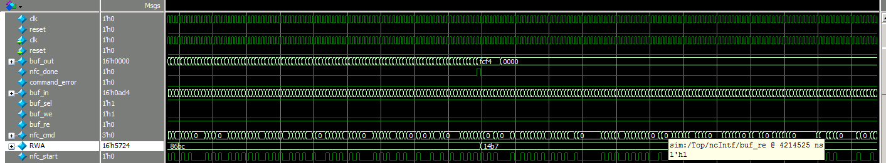
Deterministic Approach Verification Results

Slide 19
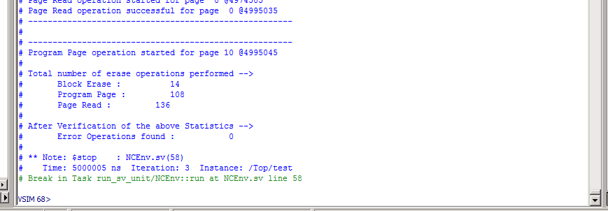
Functional Verification Results

Slide 20
DC Synthesis
Used Synopsys Design Compiler (DC) to perform hardware synthesis.
This takes an RTL hardware description and a standard cell library as input and produces a gate level netlist as output.
The Output obtained is a complete structural description.
Generated using Tcl scripts.
DC synthesis flow

Slide 21
Emulation of Design
Emulation on TBX Mode.
Environment - Veloce Solo emulator.
TBX mode emulation involves both the host link and co-simulation link.
Implementation-
Interface and DUT - Veloce
Untimed Testbench - Server
Definition of tasks
Communication to hvl
Test vector generation

Slide 22
Speed up achieved
To speedup, Simulators are event driven.
Speedup in TBX mode is obtained by reducing the number of interactions between server and the Veloce through the two links.
In Veloce mode ~ 1 minute
In Puresim mode = 1minute 3 seconds
Speedup achieved = 5%

Slide 23
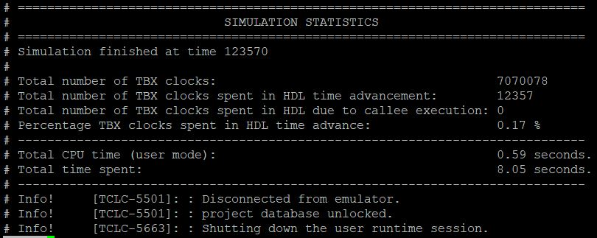
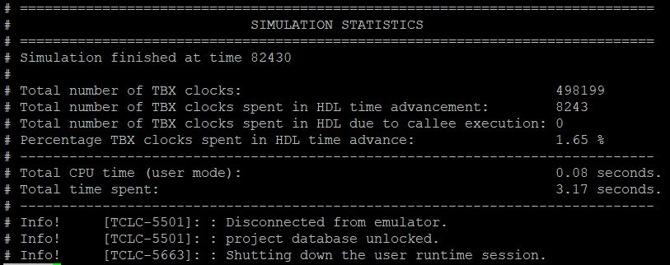
Emulation Results
Memory Controller
NAND Flash Controller

Slide 24
Challenges Faced
Design:
Timing control
Region based event handling
Designing using synthesizable constructs
Verification:
Hierarchical test environment creation
Hierarchical calls using handles
Concurrent thread execution of test vectors
Region based event handling
Designing using synthesizable constructs
Emulation:
Making the top hvl module untimed. (Implicit FSM approach)
Complying with XRTL constraints on modeling tasks.

Slide 25
Future Scope
Operations to be implemented
Read ID
Random Access
Program Page
Page Read
Functional Verification
Reference Model Design
Assertion based BFM
Checker
Functional Coverage

Slide 26
References
LATTICE Semiconductor NAND Flash Controller reference design manual.
Data sheet of Samsung K9F1G08R0A NAND Flash.
Design Compiler user guide.
Veloce user guide.
Veloce Languages and Communication Channels User Guide.
Veloce Reference manual.

Slide 27


Your Queries Please ?

